Slide 1
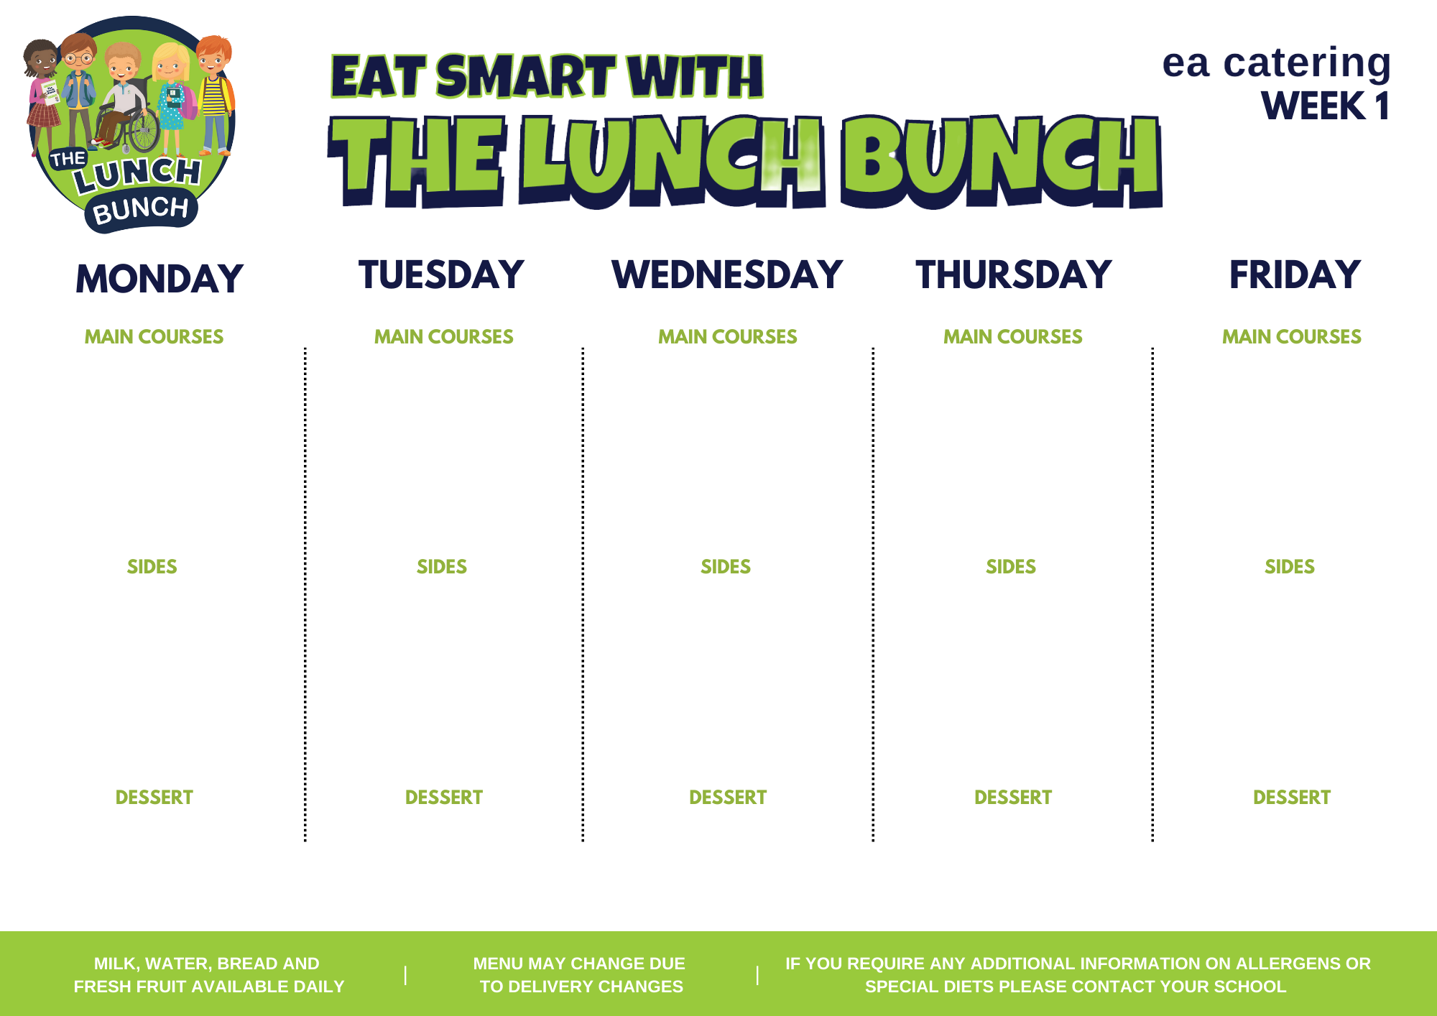
Week Commencing:
Sep 18, Oct 16, Nov 13, Dec 11, Jan 15, Feb 12
Spaghetti Bolognaise
Or
Crispy Cod Fishcake with Tomato Ketchup
Classic Margherita Pizza
Or
Italian Chicken & Tomato Pasta Bake & Garlic Bread
Lunch Bunch Chicken Curry & Naan Bread
Or
Chicken Panini & Coleslaw
Roast Chicken, Stuffing & Rich Gravy
Or
Beef Olive
Hot Dog
Or
Chicken Wrap & Sweet Chilli Salsa
Baton Carrots & Baked Beans
Mashed Potato, Salad
Garden Peas & Coleslaw
Chipped Potato, Mashed Potato
Steamed Broccoli & Sweetcorn
Oven Roasted Potato Wedges, Rice
Baton Carrots & Savoy Cabbage
Mashed Potato
Garden Peas & Spaghetti Hoops
Chipped Potato, Mashed Potato
Homemade Ginger Biscuit & Custard
Strawberry Jelly, Ice Cream & Fruit
Banana Yoghurt Pot
Chocolate Sponge & Custard
Fresh Fruit & Yoghurt

Slide 2
Week Commencing:
Aug 28, Sep 25, Oct 23, Nov 20, Dec 18, Jan 22
Chicken Nuggets
Or
Homemade Lasagne
Spaghetti Bolognaise
Or
BBQ Chicken Pizza
Lunch Bunch Chicken Curry & Naan Bread
Or
Golden Crumbed Fish Fingers
Roast Turkey, Stuffing & Rich Gravy
Or
Salmon Fishcake
Steak Burger & Tomato Ketchup
Or
Chicken Crumble
Steamed Broccoli & Garden Peas
Chipped Potato, Rice
Sweetcorn & Baked Beans
Diced Potatoes, Mashed Potatoes, Salad
Garden Peas
Rice, Salad, Mashed Potato
Cauliflower & Baton Carrots
Mashed Potato
Sweetcorn & Salad
Or
Chipped Potato, Rice
Ice Cream, Chocolate Sauce & Sliced Pears
Fruit & Rice Pudding
Rice Krispie Square & Fruit
Fruit Muffin
Flakemeal Biscuit & Fruit

Slide 3
Week Commencing:
Sep 04, Oct 02, Oct 30, Nov 27, Jan 01, Jan 29
Golden Crumbed Fish Fingers
Or
Mighty Mac ‘n’ Cheese with Garlic Bread Slice
Beef Meatballs with Italian Tomato & Basil Sauce
Or
Margherita Pizza
Lunch Bunch Chicken Curry & Naan Bread
Or
Bacon Slice
Roast Chicken, Stuffing & Rich Gravy
Or
Mexican Chilli with Nachos
Tasty Port Sausages with Tomato Ketchup or Gravy
Or
Chicken Panini & Coleslaw
Baked Beans & Broccoli & Coleslaw
Mashed Potatoes
Garden Peas & Salad
Oven Baked Potato Wedges, Pasta
Mini Corn on the Cob
Steamed Rice, Chipped Potatoes
Baton Carrots & Tossed Salad
Mashed Potato
Sweetcorn & Spaghetti Hoops
Chipped Potatoes, Mashed Potato, Salad
Artic Roll with Peaches
Shortbread, Custard & Fruit
Strawberry Jelly & Fruit
Jam & Coconut Sponge & Custard
Melon Wedge

Slide 4
Week Commencing:
Sep 11, Oct 09, Nov 06, Dec 04, Jan 08, Feb 05
Beef Bolognaise with Garlic Bread
Golden Crumbed Fish Fingers
Or
Tex-Mex Enchilada
Lunch Bunch Chicken Curry & Naan Bread
Or
Steak Burger & Gravy
Roast of the Day, Stuffing & Rich Gravy
Or
Stuffed Chicken
Oven Baked Chicken Nuggets
Or
Admiral’s Ocean Pie
Or
Stuffed Bacon Roll/Bacon Slice
Garden Peas & Savoy Cabbage
Oven Baked Potato Wedges, Spaghetti
Mini Corn on the Cob & Spaghetti Hoops & Coleslaw
Chipped Potatoes, Pasta
Green Beans & Sweetcorn
Mashed Potato, Rice
Cauliflower Cheese & Baton Carrots
Mashed Potato
Garden Peas & Baked Beans
Chipped Potatoes, Jacket Potato, Salad
Chocolate Cake & Custard
Jelly & Mandarin Oranges
Cornflake Biscuit & Custard
Ice Cream Slider & Fruit
Homemade Ginger Biscuit & Fruit

